Slide 1
tEEm Radiance
Presented By:
Manolo Ortiz
Hayden OReilly
Benjamin Reed
Notes:
Presentation time 6 minutes +- 10 seconds 30 seconds -Intro 5 minutes - body
30 seconds closing

Slide 2
Spectral Forest Motivation
Spectra that are absorbed or rejected by the forest.
CO2 absorption.
Health of the forest.
There are a plethora of uses for NIR and SWIR spectroscopy.
Create remote-deployable self-sustaining spectrometer.

Slide 3

Requirements
Deliver hyperspectral responsivity in the 350 nm to 1000nm spectrum
Design spectrometer electronics to be seamlessly integrated with a custom-tailored PCB
Work off-grid for a minimum of five days, powered by a 12V battery
Ability to sense Humidity, Temperature, and Barometric Pressure
Be capable of mobile and stationary data collection and processing
Must have self-sustaining Power Systems
Must have a user interface

Slide 4
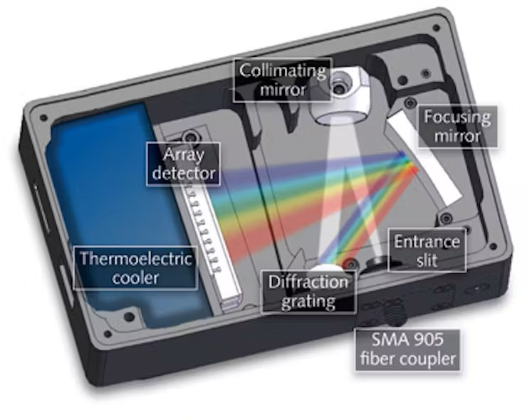
Spectrometer Concept
Light will enter through a slit
Reflect through the collimating mirror
Light is diffracted and separated into the light spectrum wavelengths
Wavelengths are focused through a mirror
Wavelengths are detected by array

Slide 5

Constraints
Budget
Size
Power usage
Frequency interference
Weight
Battery

Slide 6
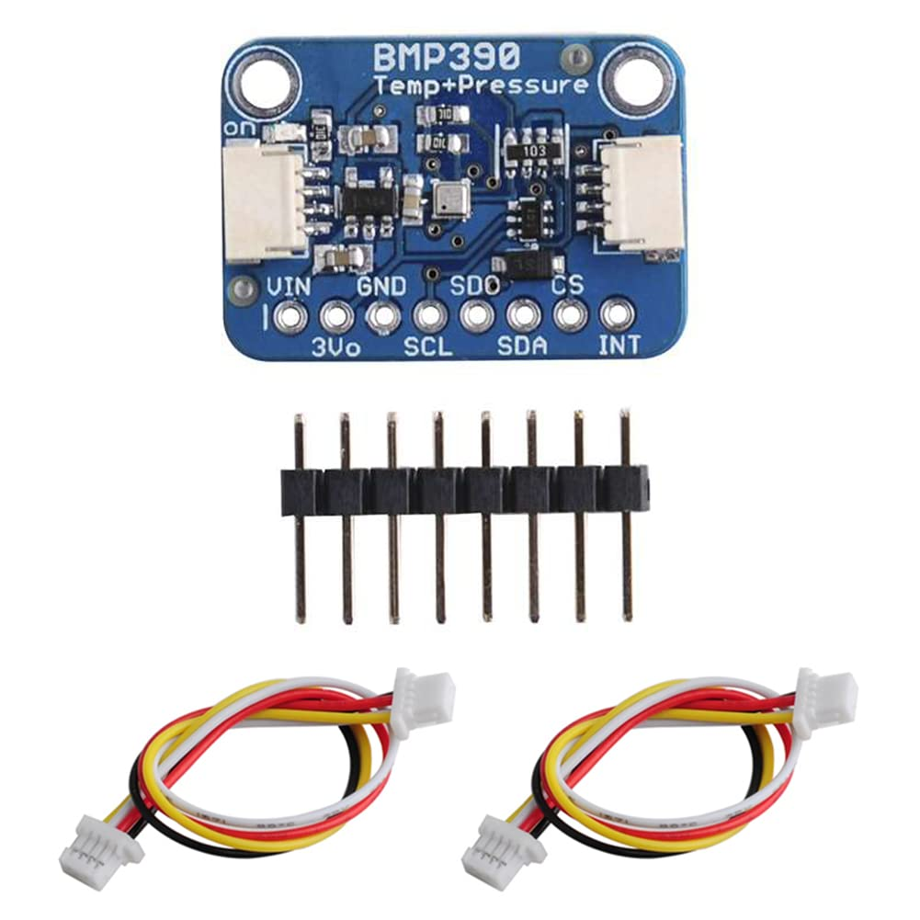
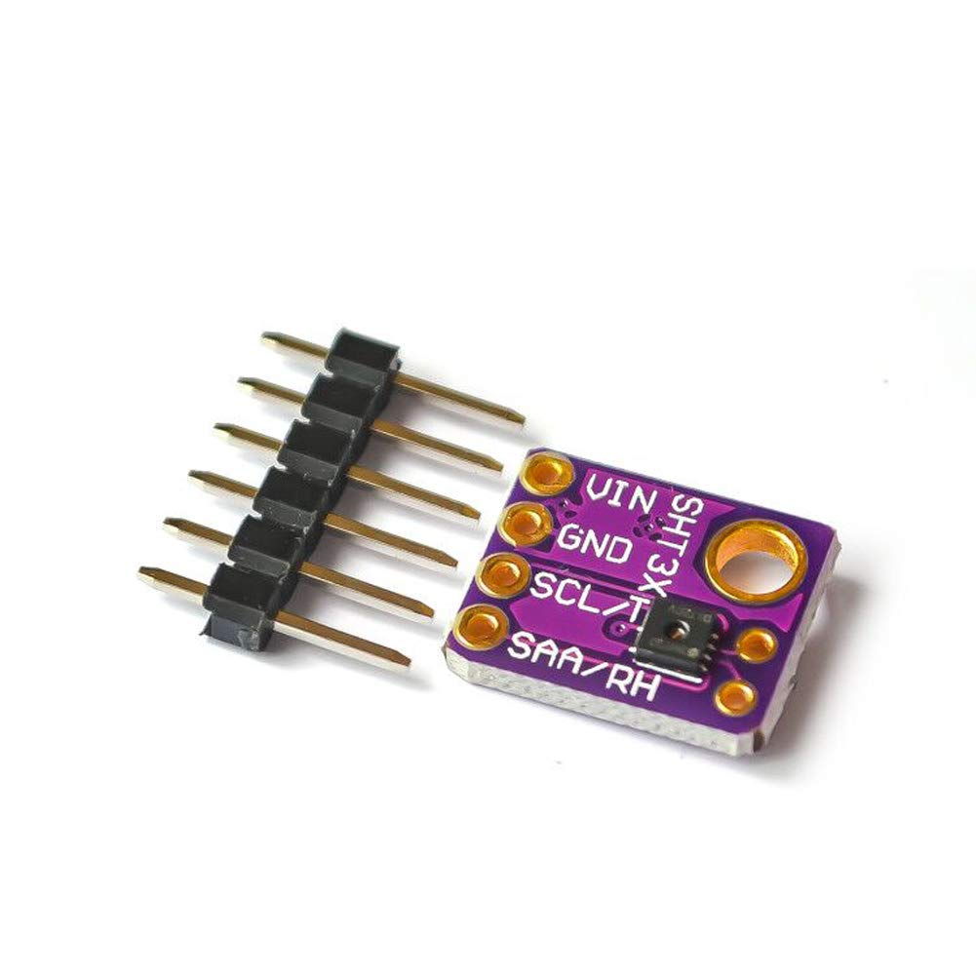
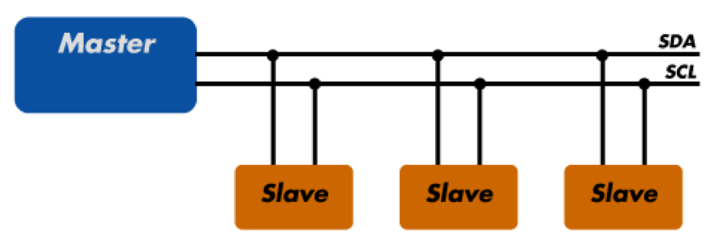
Environmental Sensors
Sensors to measure barometric pressure, temperature, and humidity
SHT31-D, BMP390
MicroPython
Usage of I2C protocol for minimal wire usage
Senors provide useful data for how measurements may vary
Data will be shown on UI

Slide 7
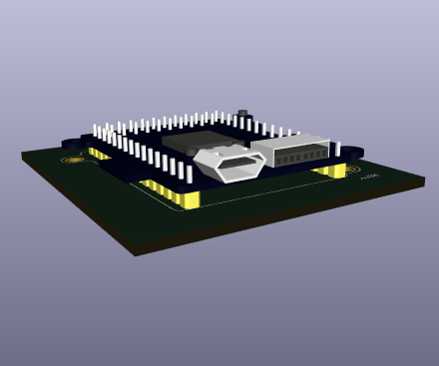
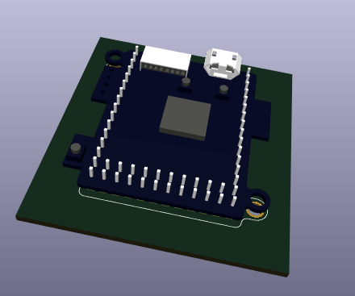
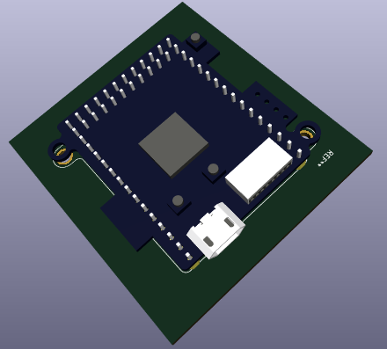
Spectral Forest Custom PCB:

